Slide 1
Epic Loss
A web application for applying duplicate epic or correction of epic

Slide 2
Introductions
This application will also help general citizen for application to issue duplicate epic card as well as correction of epic card.
In this application auto generated mail, SMS facility ,Online payment system etc. has been implemented.

Slide 3
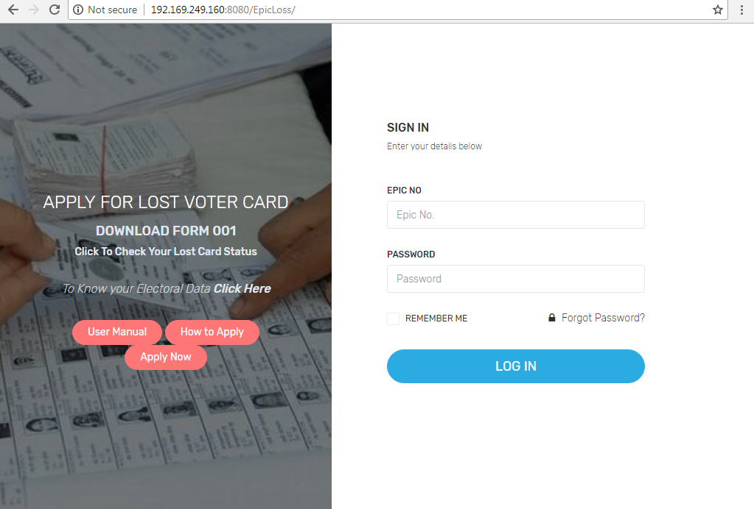
User login
User have to provide correct login credentials.

Slide 4
Mobile app welcome screen
This is mobile app welcome screen .

