Slide 1
Polling Area Survey App
(PASA)

Slide 2
Introduction
Pasa app will be useful using GIS Layer survey to inspect the vulnerable situation of individual Polling Station section area within a Assembly Constituency.
Depending on Survey information , a themetic map will be constructed to analyse vulnerability information.

Slide 3
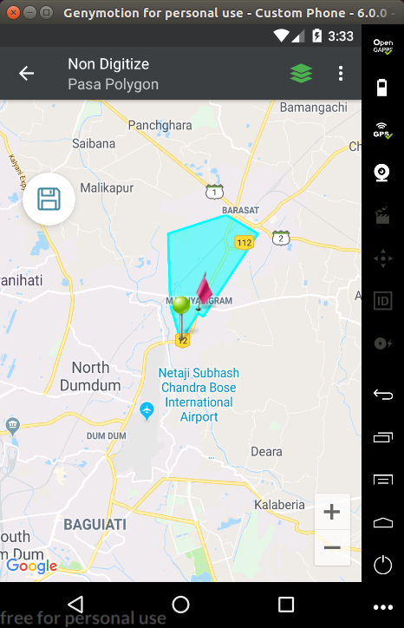
PASA Survey
PASA Survey on colored area
Saved button visible to save
Upload data to server
Surveyor Module​

Slide 4
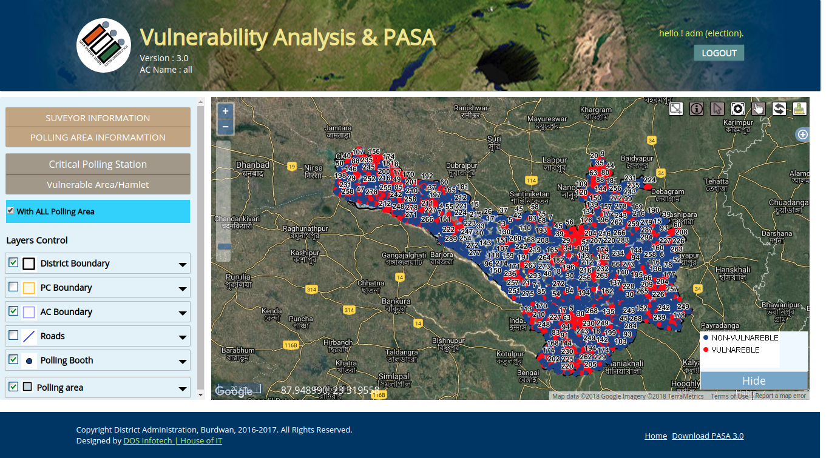
GIS
Representation
View vulnerable polling stations, area etc.
Admin Module​

