Slide 1
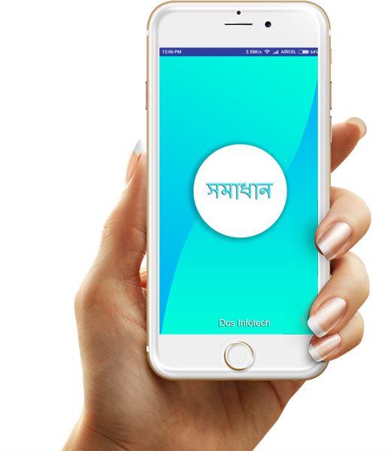
সমাধান
Solution for every municipal citizen

Slide 2
Advantages
Fast & Efficient
Register your complaint faster & Efficiently.
Save Time
No need to visit your municipality thousand times &
go through thousands of paper work.
Save Paper
Digital complaint so no need to waist papers on each complaint.

Slide 3
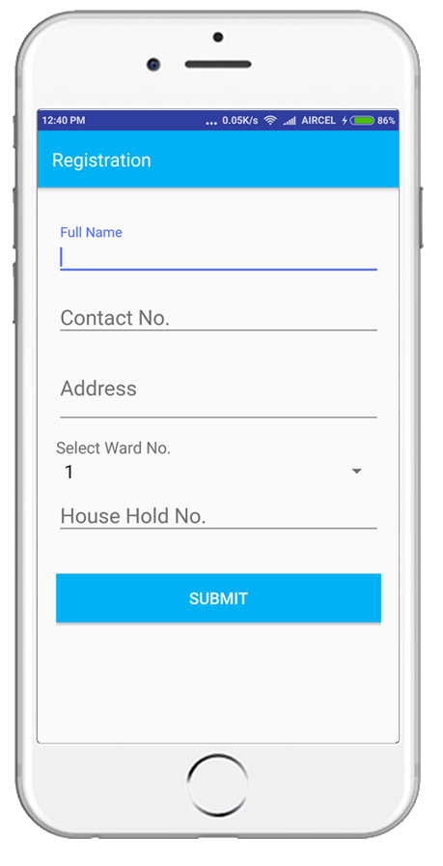
Registration
Easy registration with ward and house hold number.

Slide 4
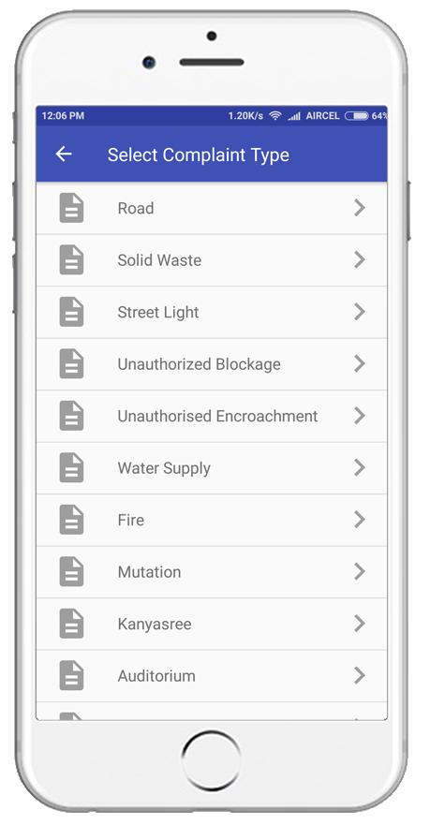
Select your complain Type
Select a complain type that you would like to lodge
from various complains

Slide 5
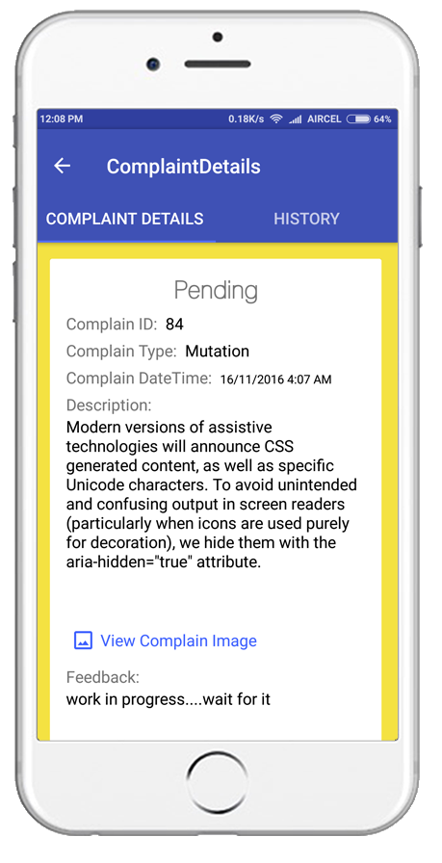
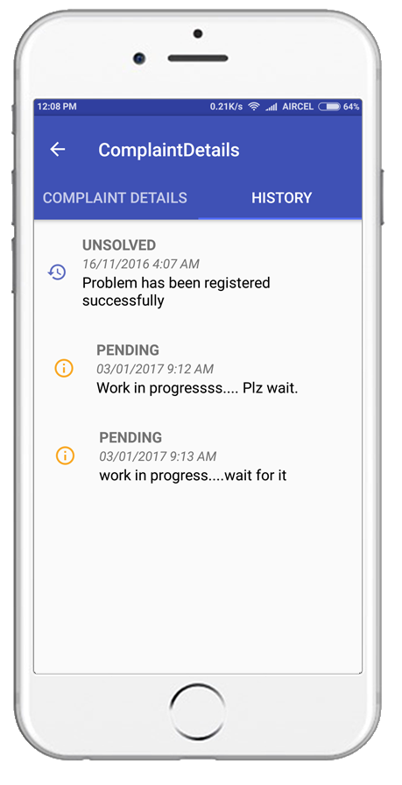
Track Complaint
View complaint status and
track your complaint.

