Slide 1
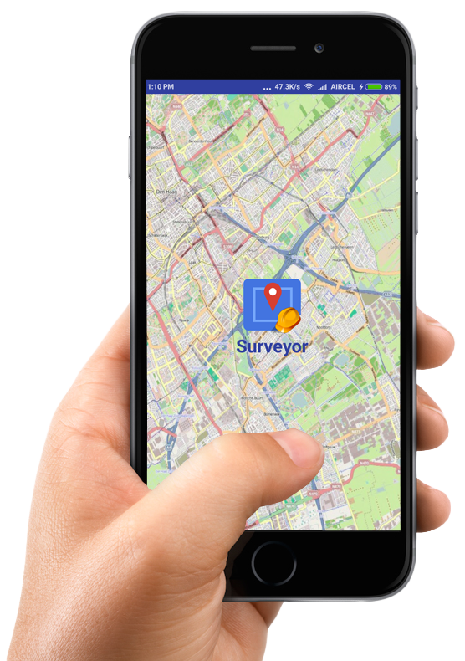
Surveyor
Your survey partner

Slide 2
Introduction
We have developed an android app which does both efficiently and in a cost
effective way. All types of GIS features can be collected along with MIS
information. In addition the data can be sent to the server from the field directly.

Slide 3
Advantages
Google Map interface to identify the points more precisely.
Easy to survey point, line and area features .
Collect MIS data of the survey easily.
Save survey data and upload later.
Upload survey data directly to server.
Use exported data in GIS software i.e. QGIS

Slide 4
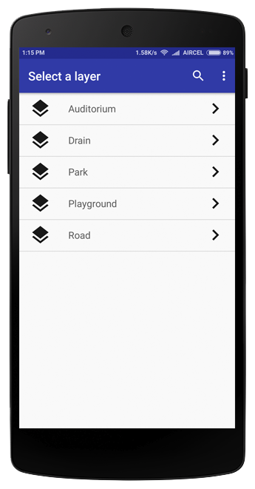
Select Layer
Select the layer you wish to survey.

Slide 5
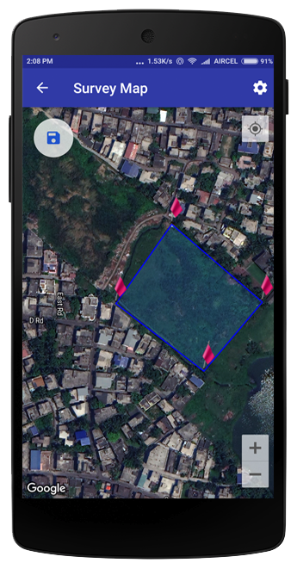
Survey Map
Google Map interface with 4 types of map.

